Slide 1
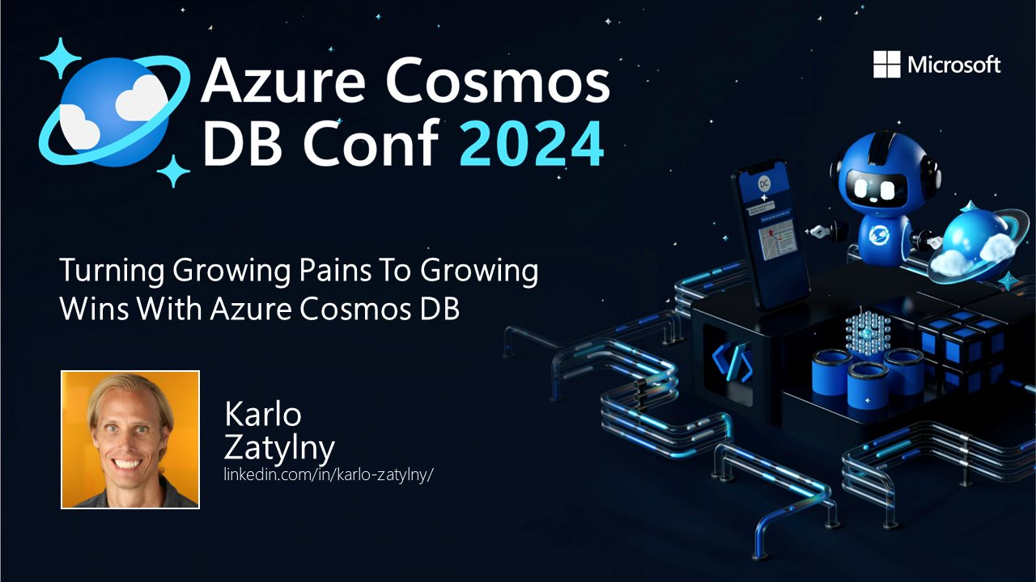

Slide 2

In warfare, there are no constant conditions. He who can modify his tactics in relation to his opponent will succeed and win.
The Art of War
Notes:
Cosmos can require you to adapt to changing as your application grows. As your application go up and to the right, you will find that you run into a variety of limitations in your app that you might not have been expecting.

Slide 3
Growth Spurts – A Summary
Increased traffic​
Noisy neighbors​
Regular updates​
When to cache​
Splitting containers​
Finding 429 errors​
Traffic Spikes​
20 GB Partition Limit
Autoscale​
Flexible consumer​
Redesign​
Redis or not​
Go out on your own big customer​
Scale when Cosmos DB says no​
Efficient cleanup
Partition Key Choice
Notes:
What we will analyze today. The left hand side was the challenge and the right the solution

Slide 4
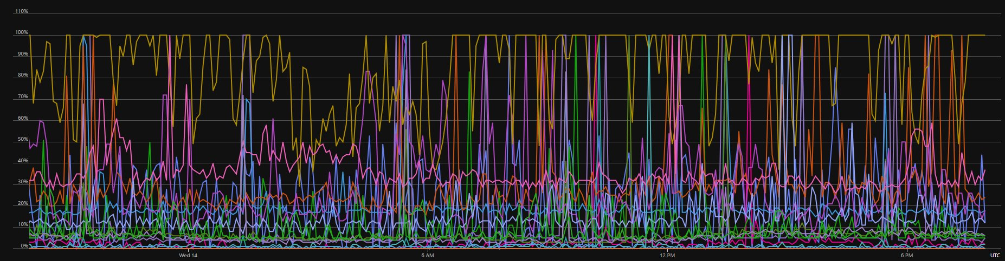
Things that work small
Don’t always work when you’re big
Notes:
After you have your first few customers your container throughput chart may look like this.

Slide 5
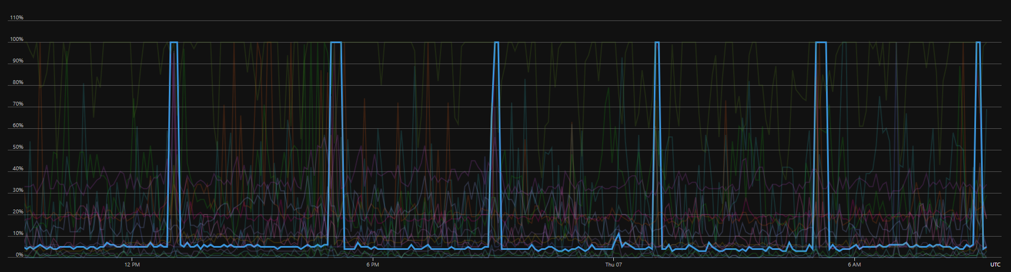
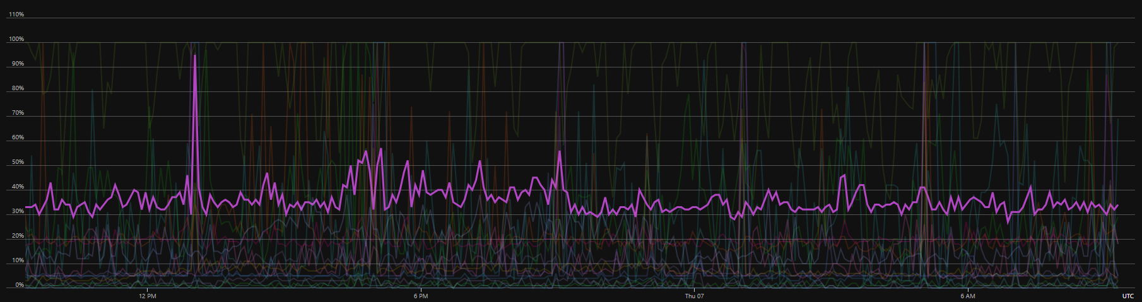
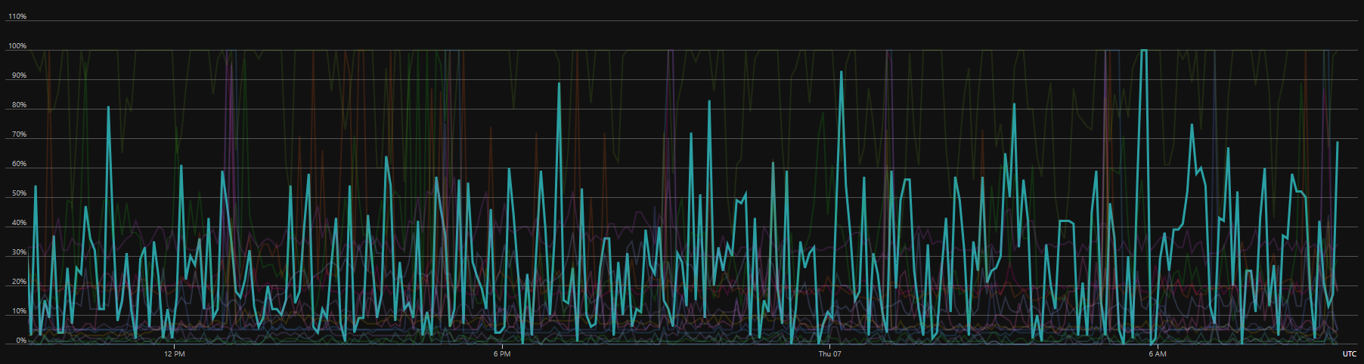
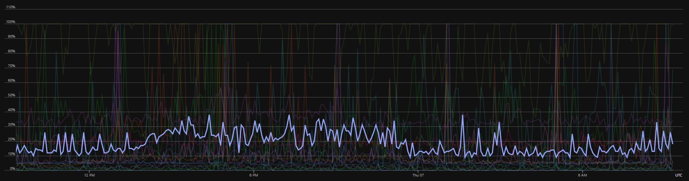
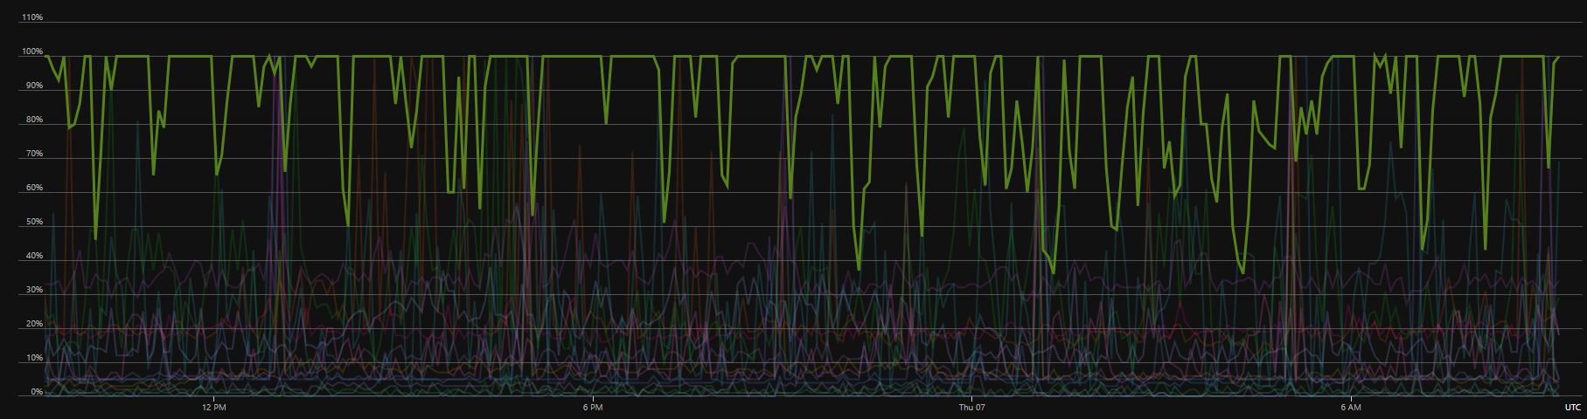
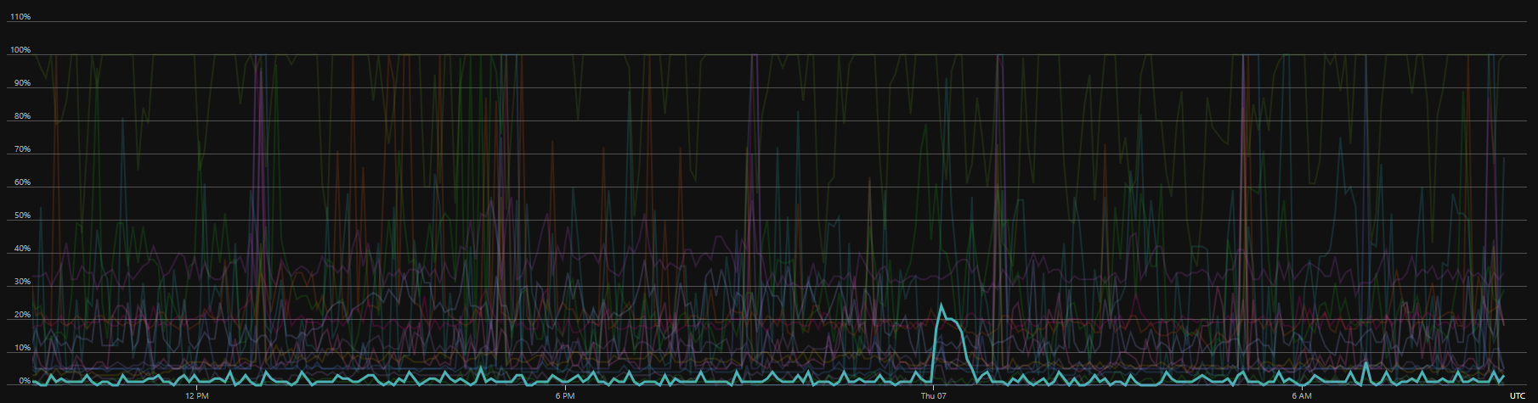
Notes:
Some of these lines are fine. Others require fixing.

Slide 6
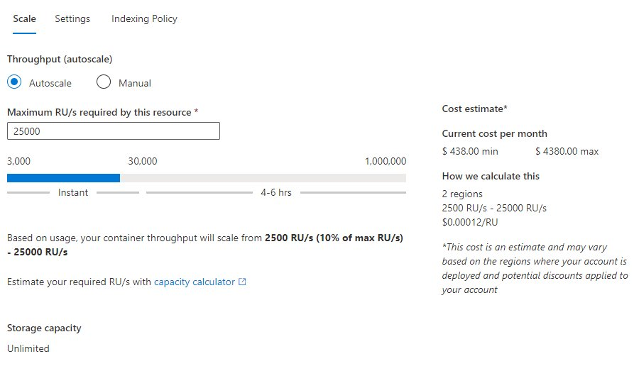
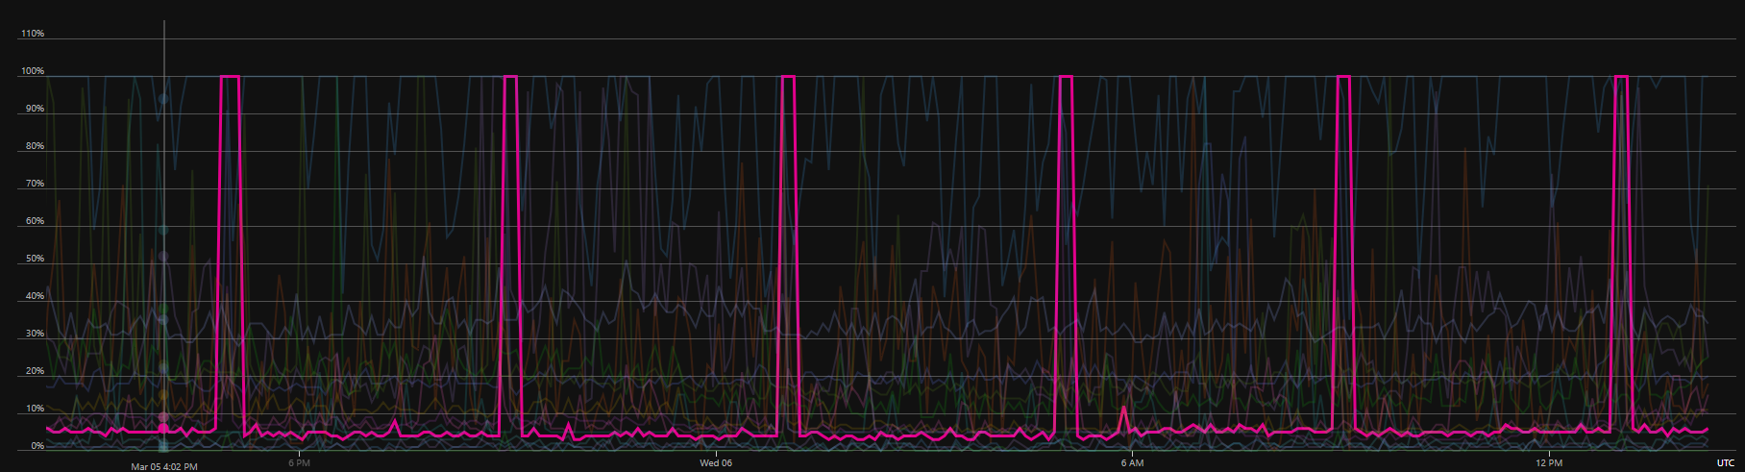
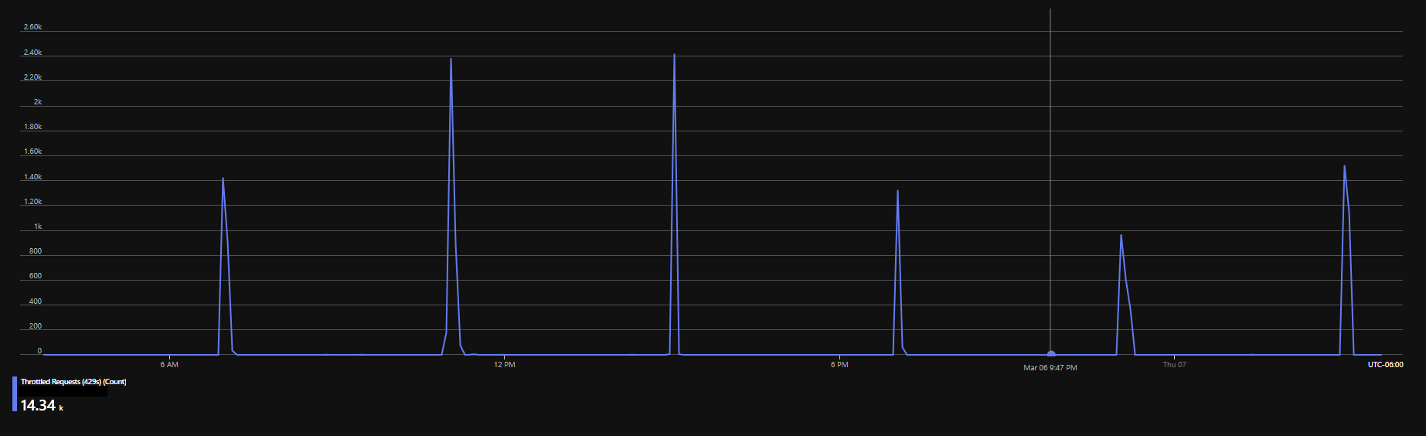
Scale!
Avoid 429s by using Autoscale​
Accept your minimum as your base cost​
Watch for spikes​
Try to be smooth
Notes:
There is danger in scaling your peaks.

Slide 7
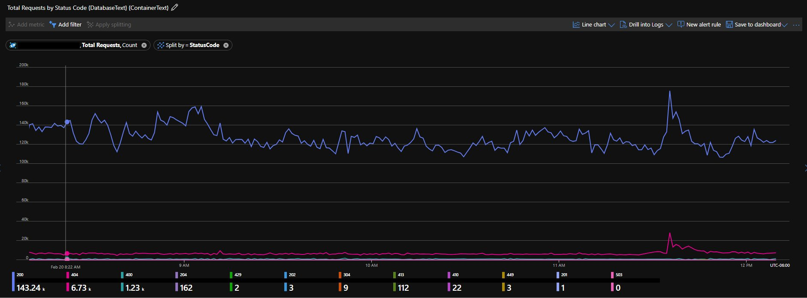
Day 1ish
All customers in same containers, but split by partitions into groups​
Partition ID included customer unique identifier​
All containers were on manual scale to control cost​
We were small with just over 100 customers with less than 100,000 active devices (our unit of scale)​
Broad containers design with a variety of document types in different partitions within the database

Slide 8
The Initial Growth Pattern
New customer onboarded; new devices start authenticating​
Scale setting not high enough – 429 errors​
Look at trend to analyze next good scale setting​
Update manual scale setting​
Wait for sales to sell some more​
No triggers of key events that lead to proactive changes

Slide 9
To fight and conquer one hundred times is not the perfection of attainment, for the supreme art is to subdue the enemy without fighting.
The Art of War

Slide 10
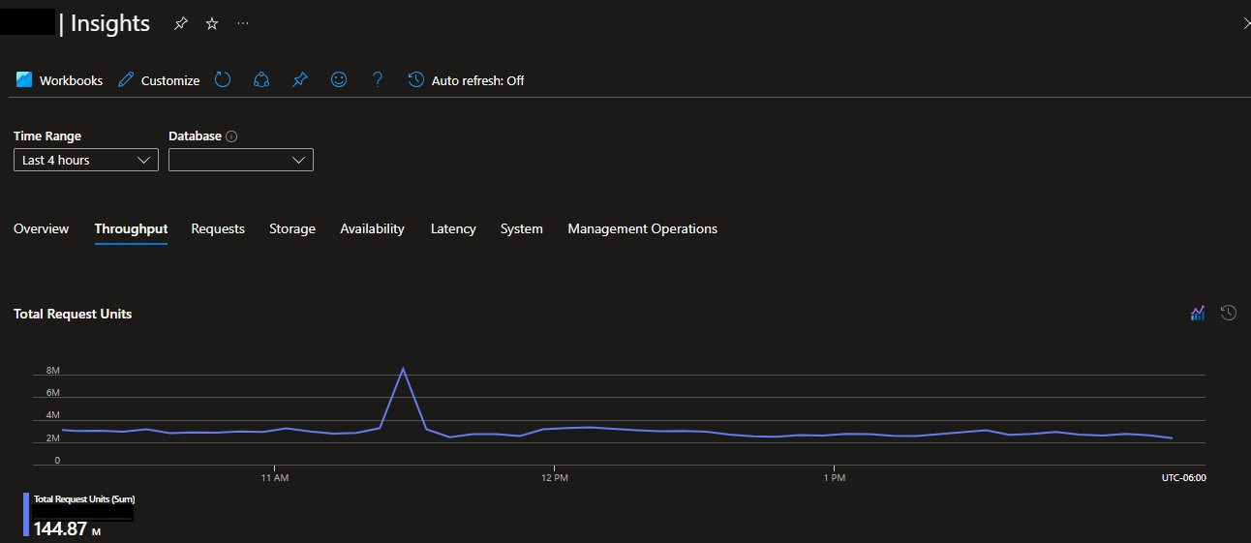
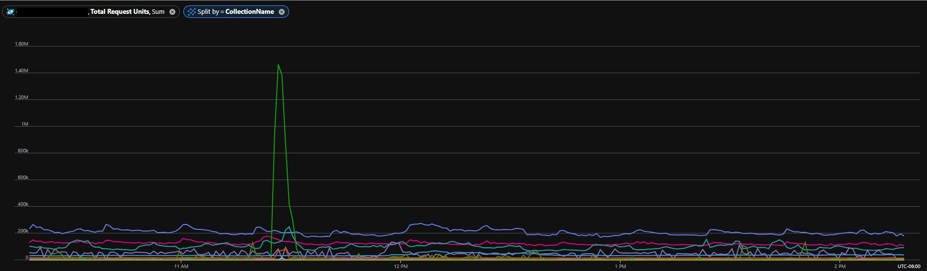
The Prepared Pattern
Analyze data in container for RU utilization​
Look for times, partitions, and geos where the data is coming from.​
Set autoscale to take account of your maximum. 429s are very bad in our main authentication flow.​
Find correlations between scale in other areas of the environment and the overall scale of Azure Cosmos DB (e.g. scale of K8s containers, Service Bus Queue throughput)

Slide 11
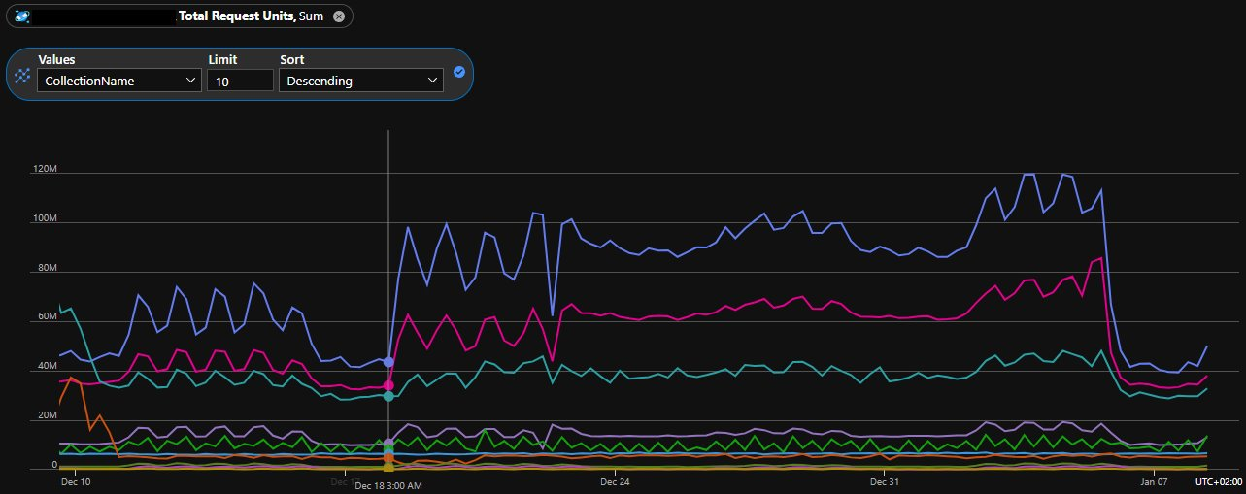
Release A Feature
Can you see when we released a new feature?
Release Preparation
Monitor 429s and RUs​
Watch application latency, errors, throughput, and saturation​
Be ready to roll back​ or use feature flags
Prepare for scale
Notes:
Let’s play a fun game. Can you see when we released? And where we disabled the new feature?

Slide 12
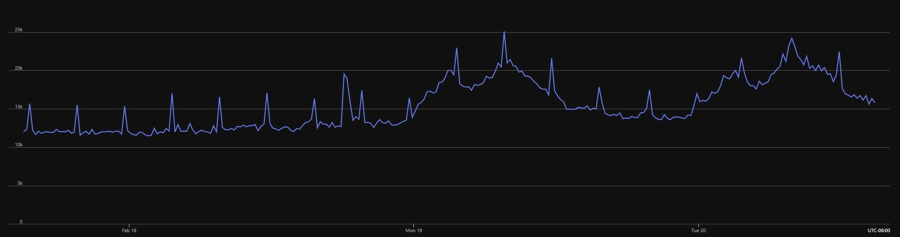
Smooth Cleanup
Please data responsibly
Continuous cleanup
Different storage
Partition wisely
Guess when our cleanup script runs
Notes:
Great example of what works small but not big

Slide 13
It is the rule in war, if our forces are ten to the enemy's one, to surround him; if five to one, to attack him; if twice as numerous, to divide our army into two. If equally matched, we can offer battle; if slightly inferior in numbers, we can avoid the enemy; if quite unequal in every way, we can flee from him.
The Art of War
Notes:
You must prepare for different sizes of customer and their different sizes of data. The goal is to not flee from even the biggest of customers.

Slide 14
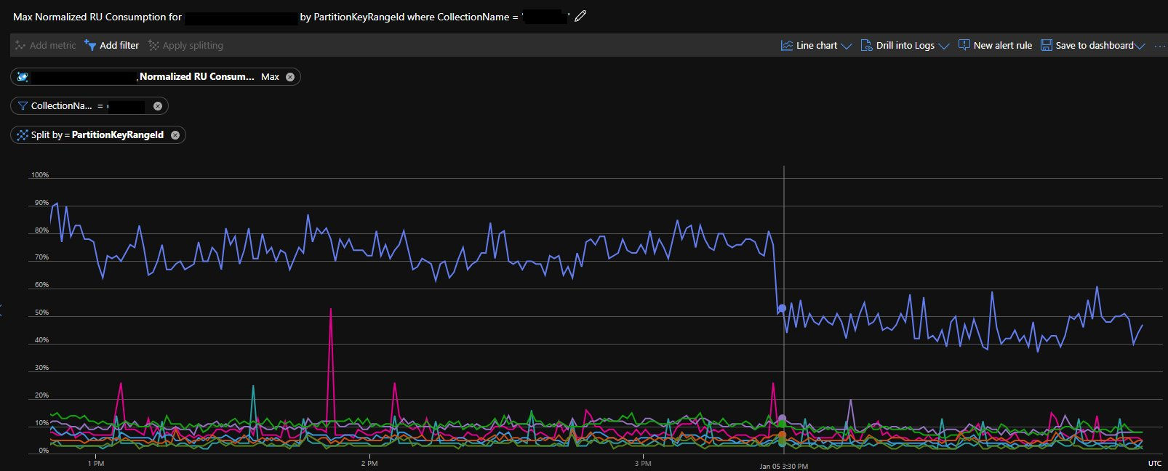
Hey There Big Customer
Not All Customers Were Created Equal
Flexibility Is Not Just For Athletes
Write code so that each customer has the potential to have their own container.​
Azure Cosmos DB connection classes inherit and can be polymorphed to use current customer settings for collection name.
Be ready to move data. Understand if moving data will cause down time or delays

Slide 15
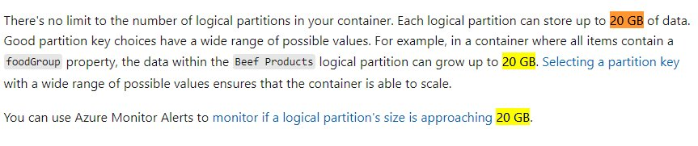
So You’re Saying There’s A Chance
Logs data wrongfully partitioned – have your partitions scale properly with your data size potential – partition key smart​
Large active customers eat up 20 GB for breakfast​
Allow for movement of data in your system to allow for wrong decisions​
If you have shared partitions across customers then a noisy neighbor can shut down more than just one customer​
https://learn.microsoft.com/en-us/azure/cosmos-db/partitioning-overview
Notes:
Read the docs and be ready for big data. There’s a chance that someone will send you more than you think.

Slide 16
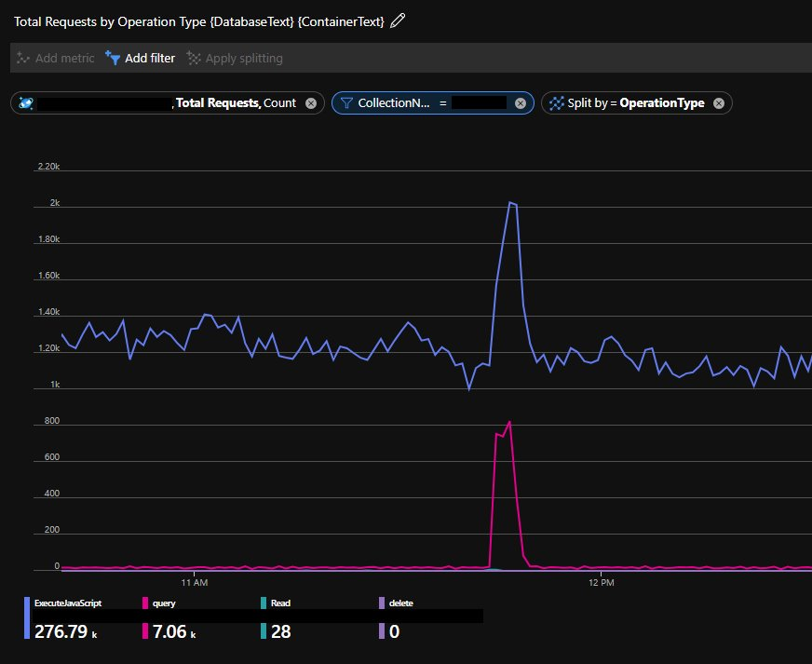
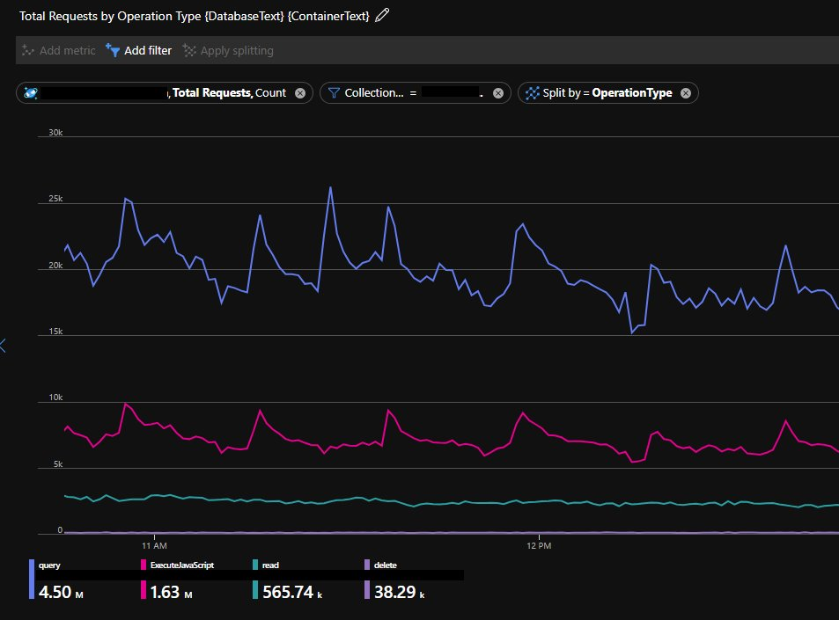
When To Cache
Heavy Write
Heavy Read
Notes:
Data driven decisions. Our main data flow needs to be fast.

Slide 17
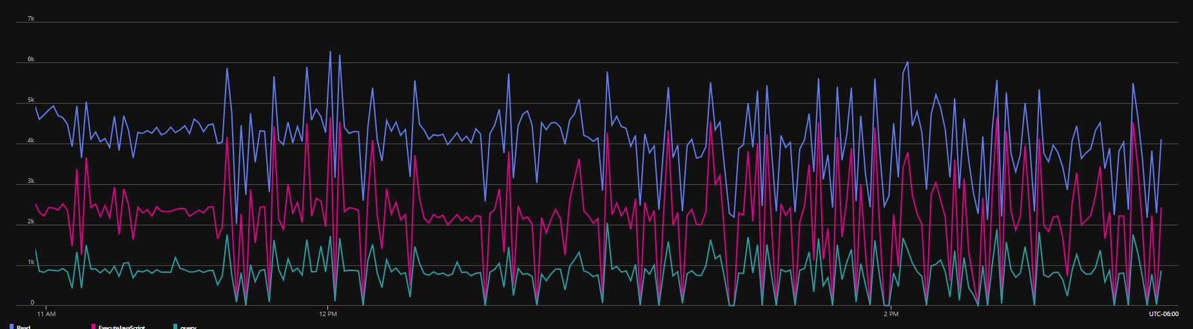
When Not To Cosmos
The Obvious Reasons
Other Reasons
If you need efficient JOINs
If you don’t need the fancy features
If you don’t understand your data
If the data doesn’t have high value

Slide 18
Summary
Watch the metrics​
Be ready to split​
Understand your data​
Be ready to scale​
Beware of things that work well when you're small

Slide 19
Victorious warriors win first and then go to war, while defeated warriors go to war first and then seek to win.
The Art of War
Notes:
Hopefully this talk hopes you become a victorious warrior first.

